Slide 1

Institute of Aeronautical Engineering
(Autonomous)
Department of Electrical and Electronics Engineering
Multi-Power Supply Using 4 Different Sources for No Break
Power Supply
Batch Members
20955A0227 – T.RAKESH
20955A0225 – B.PRUDHVI KUMAR
20955A0254 – G.SANDEEP
Supervisor Name
Mr. A.Srikanth
Assistant professor
Electrical and Electronics Engineering
Date: 06/12/2021

Slide 2
Abstract
ABSTRACT: Power is most important requirement for all of us. We know that due to large demand of electricity and due to limit capacity of power plant at generating station, power cut off is common for all us. Due to limited amount of power generation at power station and due to shortage of nonrenewable continuous supply source it beings a biggest challenge in whole world. If you see all around us you will observe that due to discontinuity of power supply, many problems have been faced by people in their everyday use. This type of power failure create problem for data centers, hospitals and some research work.

Slide 3
Abstract
This is a biggest reason that every countries are researching for the work to supply a continuous power with good efficiency and with good regulation. In this project we can combine the renewable and non-renewable energy sources to get the continuous power supply such as mains, solar, inverter, small diesel generator. The power cut of these sources can be manually done by switches. The continuous supply to load can be given by automatic operation of relay, relay driver IC with the help of Arduino Nano.

Slide 4
In present time’s electric supply is very essential to the human beings. Uninterrupted power supplies are needed in almost all of the areas in our life-in household applications, research institutions, hospitals etc. Due to the increased demand of power and large consumption of conventional energy sources, which are limited in nature, there is a need to shift from conventional methods of energy production to a better approach using hybrid systems to economically use the conventional and non-conventional sources. This paper deals with the automation of switching between different sources so as to get uninterrupted power supply.

Slide 5
Introduction
The project is designed to automatically supply continuous power to a load through one of the four sources of supply that are: solar, mains, generator, and inverter when any one of them is unavailable.Four switches are used for four respective sources. These are connected to a microcontroller of 8051 family that provides input signals to it. Whenever a switch is pressed it shows the absence of that particular source.

Slide 6
A relay driver is used that receives microcontroller generated output and switches that particular relay to provide continuous power supply. A lamp is used as a load for demonstration purpose which draws power from main. When main fails to supply power, automatically next available source is used say inverter. If inverter fails then the next one is used and so on. An LCD is also used to display which source is being currently used for power supply.Therefore, this project provides an effective solution to provide an alternative power supply during frequent power cuts. In this project uses four switches to demonstrate the respective failure of that power supply.

Slide 7
When any of the switches is pressed it shows the absence of
that particular source, switches are connected to microcontroller as input signals. A microcontroller of 8051 family is used. The output of microcontroller is given to the relay driver IC, which switches appropriate relay to maintain uninterrupted supply to the load.The output shall be observed using a lamp drawing power supply from mains initially. On failure of the mains supply (which is actuated by pressing the appropriate switch) the load gets supply from the next available source, say an inverter.

Slide 8
If the inverter also fails it switches over to the next available source and so on. The current status, as to which source supplies the load is also displayed on an LCD. As it is not feasible to provide all 4 different sources of supply, one source with alternate switches are provided to get the same function.

Slide 9
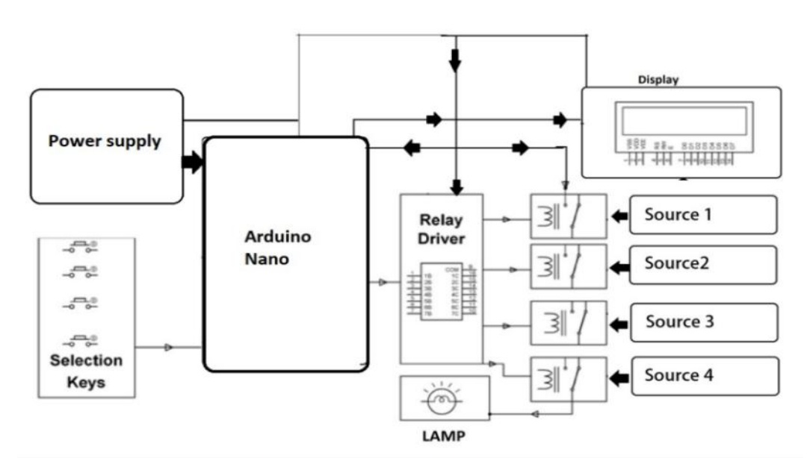
Block Diagram

Slide 10


